Slide 1


Data
Analysis

Slide 2


Today's agenda
Project recap
Problem
The Analytics team
Process
Insights
Summary

Slide 3

Social Buzz is a Social media and Content
creation company. Due to their Rapid growth
of the company the amount of the data that
they collect and must and it must be analyzed.
Project Contains :
- An audit of their big data practice.
- Recommendations for a successful IPO .
- An analysis of their content categories that highlights the top 5 categories with the largest aggregate popularity .
Project Recap

Slide 4


o
Problem
Over 100,000 pieces of content
Analysis to find social buzz top most popular categories of content.

Slide 5
Andrew Fleming (Chief Technical Architect),
Marcus Rompton (Senior Principle),
Michelle Grove
(Data Scientist),
Jaiganesan N
(Data Analyst)
The Analytics team

Slide 6
PROBLEM UNDERSTANDING
Process
1
2
DATA COLLECTION
3
DATA CLEANING
4
MODAL DEVELOPMENT
5
ANALYSE AND INTERPRETATION

Slide 7

Insights
Content Category :
Animals, Science, Healthy eating, Technology, Food
Have high Popularity.
Content Type :
Photos and Video have high sentiment score and It also have high count.
Sentiment :
Positive reaction has stack more than 50% among three sentiment.

Slide 8
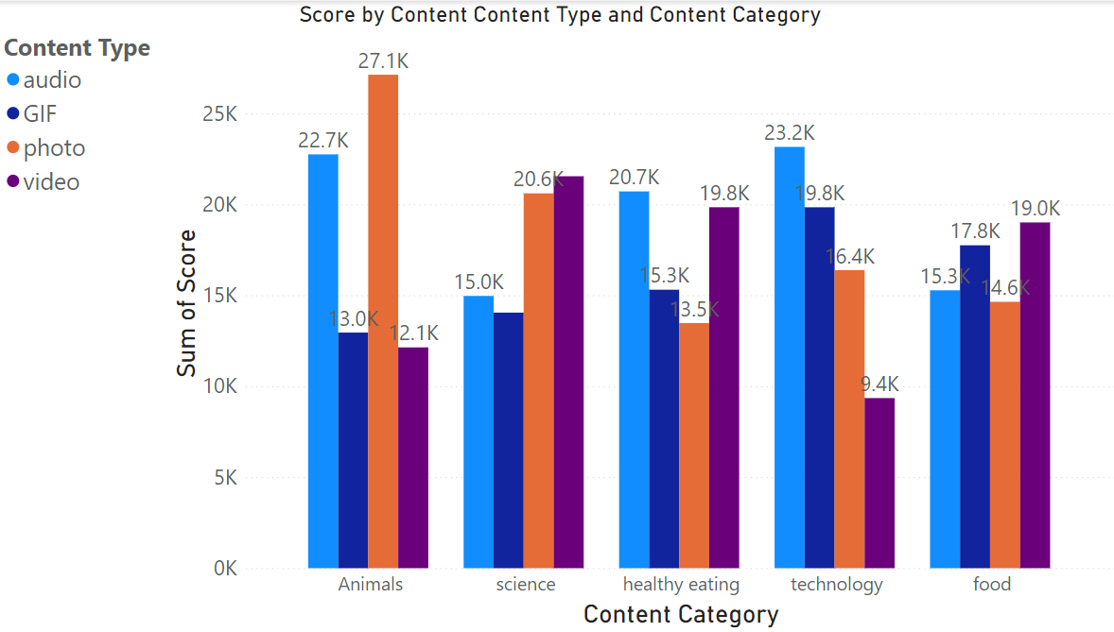

Slide 9
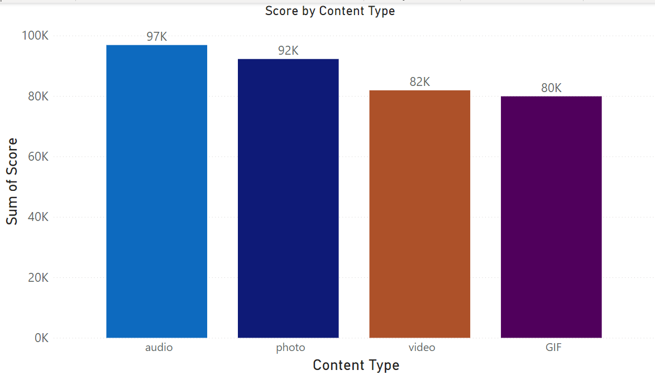

Slide 10
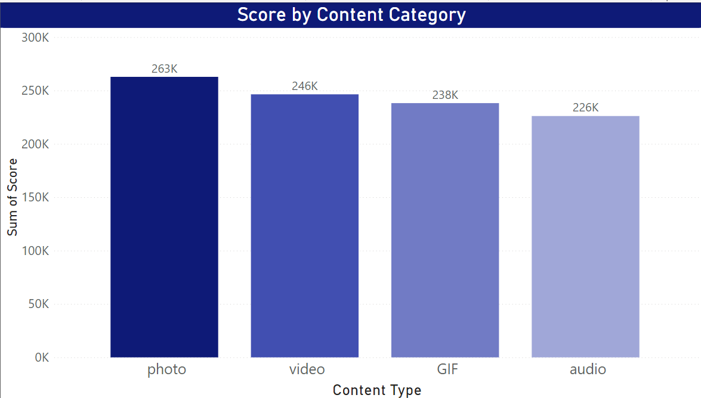

Slide 11
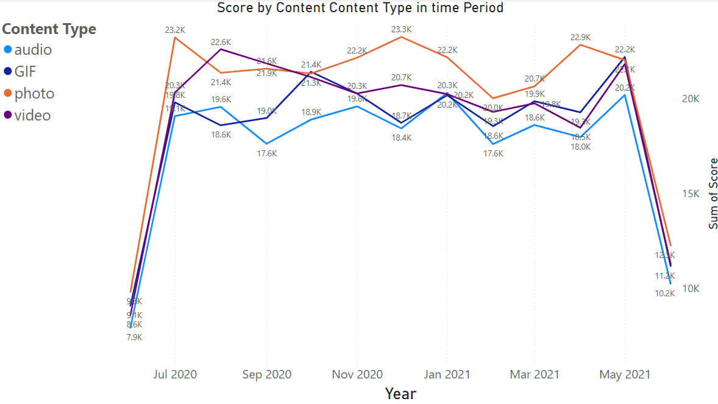

Slide 12

Animals and science are the two most
popular categories of content,
showing that people enjoy "real-life“
and "factual" content the most.
Food is a common theme with the
categories with "Healthy Eating“
ranking the highest. This may give an
indication to the audience within your
user base. Photos and Videos are the common type of content sharing methods ,so you can improve that with new features.
Summary

Slide 13

Thank you!
ANY QUESTIONS?

